Slide 1
SQL ROLLUP AND CUBE

Slide 2
Introduction to SQL ROLLUP
The ROLLUP is an extension of the GROUP BY clause. The ROLLUP option allows you to include extra rows that represent the subtotals, which are commonly referred to as super-aggregate rows, along with the grand total row.
By using the ROLLUP option, you can use a single query to generate multiple grouping sets.

Slide 3
Grouping sets
Note that a grouping set is a set of columns by which you group. For example, a query that returns the inventory by the category, the grouping set is (category).
Query:
SELECT CategoryID,sum(unitsinstock) qty
from Products
group by CategoryID

Slide 4
Syntax of SQL ROLLUP
SELECT
c1, c2, aggregate_function(c3)
FROM
table
GROUP BY ROLLUP (c1, c2);

Slide 5
ROLLUP HIERARCHY
The ROLLUP assumes a hierarchy among the input columns. For example, if the input column is (c1,c2), the hierarchy c1 > c2. The ROLLUP generates all grouping sets that make sense considering this hierarchy.
This is why we often use ROLLUP to generate the subtotals and the grand total for reporting purposes.
In the syntax above, ROLLUP(c1,c2) generates three following grouping sets:
(c1,c2)
(c1)
()

Slide 6
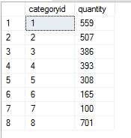
GROUP BY CLAUSE
The following statement uses the GROUP BY clause and the SUM() function to find the total inventory by category:
Query:
SELECT categoryid, SUM(unitsinstock) as quantity
from products
group by CategoryID

Slide 7
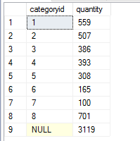
USE OF ROLLUP IN GROUP BY
To retrieve the total products of all categories, you add the ROLLUP to the GROUP BY clause as follows:
SELECT categoryid, SUM(unitsinstock) as quantity
from products
group by rollup (CategoryID)
As you can see in the result, the NULL value in the warehouse column specifies the grand total super-aggregate line. In this example, the ROLLUP option causes the query to produce another row that shows the total products by all categories.

Slide 8
COALESCE() Function
To make the output more readable, you can use the COALESCE() function to substitute the NULL value by the All categories as follows:
Query
SELECT coalesce(categoryid,10)as categoryid, SUM(unitsinstock) as quantity
from products
group by rollup (CategoryID)

Slide 9
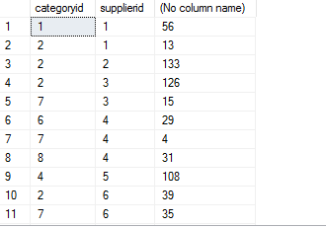
SQL ROLLUP with multiple columns example
The following statement calculates the inventory by category and suppliers:
Query:
SELECT
categoryid, supplierid, SUM(unitsinstock)
FROM
Products
GROUP BY CategoryID, SupplierID;

Slide 10
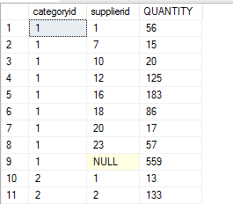
SQL ROLLUP with multiple columns example
Let’s add the ROLLUP to the GROUP BY clause:
SELECT
categoryid, supplierid, SUM(unitsinstock) AS QUANTITY
FROM
Products
GROUP BY ROLLUP(CategoryID, SupplierID);

Slide 11
SQL ROLLUP with multiple columns example
Note that the output consists of summary information at two levels of analysis, not just one:
Following each set of supplier rows for a specified Category, an extra summary row appears displaying the total inventory. In these rows, values in the supplier column set to NULL.
Following all rows, an extra summary row appears showing the total inventory for all suppliers and categories. In these rows, the values in the category and supplier columns set to NULL.

Slide 12
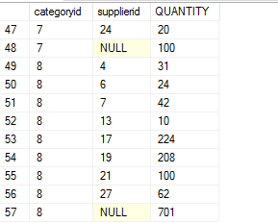
SQL ROLLUP with partial rollup example
You can use ROLLUP to perform a partial roll-up that reduces the number of subtotals calculated as shown in the following example:
Query:
SELECT categoryid, supplierid, SUM(unitsinstock) AS QUANTITY
FROM Products
GROUP BY CategoryID, rollup(SupplierID);

Slide 13
SQL ROLLUP with partial rollup example
In this example, the ROLLUP only makes a supper-aggregate summary for the supplierid column, not the categoryid column.

Slide 14
Explain this one!
SELECT YEAR(o.OrderDate) AS OrderYear, MONTH(o.OrderDate) AS OrderMonth,
c.CategoryName, SUM(od.Quantity * od.UnitPrice) AS TotalSales
FROM Orders o
JOIN OrderDetails od ON o.OrderID = od.OrderID
JOIN Products p ON od.ProductID = p.ProductID
JOIN Categories c ON p.CategoryID = c.CategoryID
GROUP BY ROLLUP(OrderYear, OrderMonth, c.CategoryName)
ORDER BY OrderYear, OrderMonth, c.CategoryName;

Slide 15
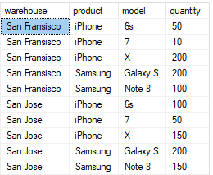
Exercise
Create table inventory as follows and insert the following values:

Slide 16
Exercise
1. Use the GROUP BY clause and the SUM() function to find the total inventory by warehouse:
2. Retrieve the total products in all warehouses by using rollup.
3.Use COALESCE function to set Null value to 'All Warehouses'.
4.Calculate the inventory by warehouse and product.
5. Introduce rollup to query 4.
6. Use rollup with only product column and show the output.

Slide 17
Introduction to SQL CUBE
Similar to the ROLLUP, CUBE is an extension of the GROUP BY clause. CUBE allows you to generate subtotals like the ROLLUP extension.
In addition, the CUBE extension will generate subtotals for all combinations of grouping columns specified in the GROUP BY clause.

Slide 18
Syntax of CUBE
The following illustrates the syntax of CUBE extension:
SELECT
c1, c2, AGGREGATE_FUNCTION(c3)
FROM table_name
GROUP BY CUBE(c1 , c2);
In this syntax, we have two columns specified in the CUBE. The statement creates two subtotal combinations. Generally, if you have n number of columns listed in the CUBE, the statement will create 2n subtotal combinations.

Slide 19
SQL CUBE with multiple columns
With one column specified in the cube , the function of rollup and cube is same.
The difference between cube and rollup occurs only when more than one(multiple) columns are specified in the cube clause.

Slide 20
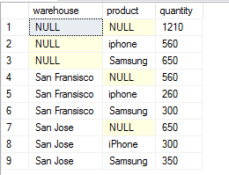
CUBE Example
SELECT warehouse,product,SUM(quantity)
FROM inventory
GROUP BY CUBE(warehouse,product)
ORDER BY warehouse,product;

Slide 21
CUBE Example
As you can see in the output, we have four subtotal rows:
The fourth and seventh rows show the total inventory of all products in the San Francisco and San Jose warehouses. The values in the product column are null.
The second and third rows display the total inventory by products which are Samsung and iPhone in all warehouses. Hence, the values in the warehouse columns are null.
The first row is the grand total that shows the total inventory in all warehouses.

Slide 22
Explain this one !
SELECT c.CategoryName, o.ShipCountry, YEAR(o.OrderDate) AS OrderYear, SUM(od.Quantity * od.UnitPrice) AS TotalSales
FROM Orders o
JOIN OrderDetails od ON o.OrderID = od.OrderID
JOIN Products p ON od.ProductID = p.ProductID
JOIN Categories c ON p.CategoryID = c.CategoryID
GROUP BY CUBE(c.CategoryName, o.ShipCountry, OrderYear)
ORDER BY c.CategoryName, o.ShipCountry, OrderYear;

Slide 23
COALESCE FUNCTION
The following statement uses the COALESCE() function to substitute null values by more meaningful data:
SELECT COALESCE(warehouse, '...All Warehouses') warehouse, COALESCE(product, '...All Products') product, SUM(quantity)
FROM inventory
GROUP BY CUBE(warehouse,product)
ORDER BY warehouse,product;

Slide 24
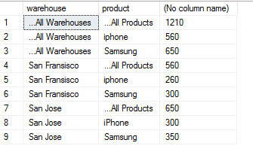
RESULT

Slide 25
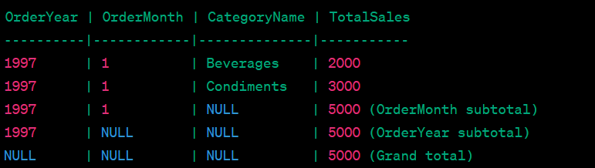
Task --- You can do it :D
Retrieve the order year, month, product name, and calculate the total sales by multiplying the quantity and unit price of each order detail (using Northwind)
perform the best suited technique such that the final result looks like this using Northwind

Slide 26
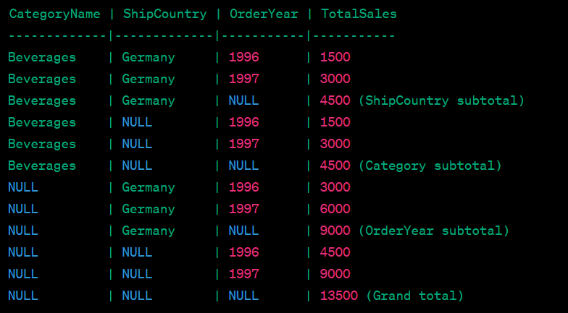
Task --- You can do it :D
3. perform the best suited technique such that the final result looks like this using Northwind

Slide 27
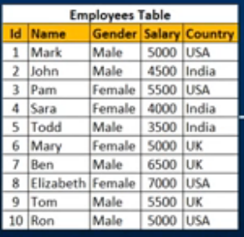
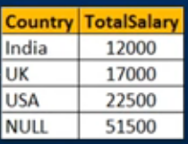
tasks
Create sample database then create the table given below and retrieve Salary by country along with grand total by rollup .
Sample output:

Slide 28
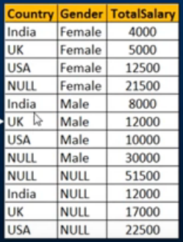
Write a query to retrieve Sum of Salary grouped by all combinations of the following
2 columns as well as Grand Total. Country, Gender by using cube.

